Slide 1
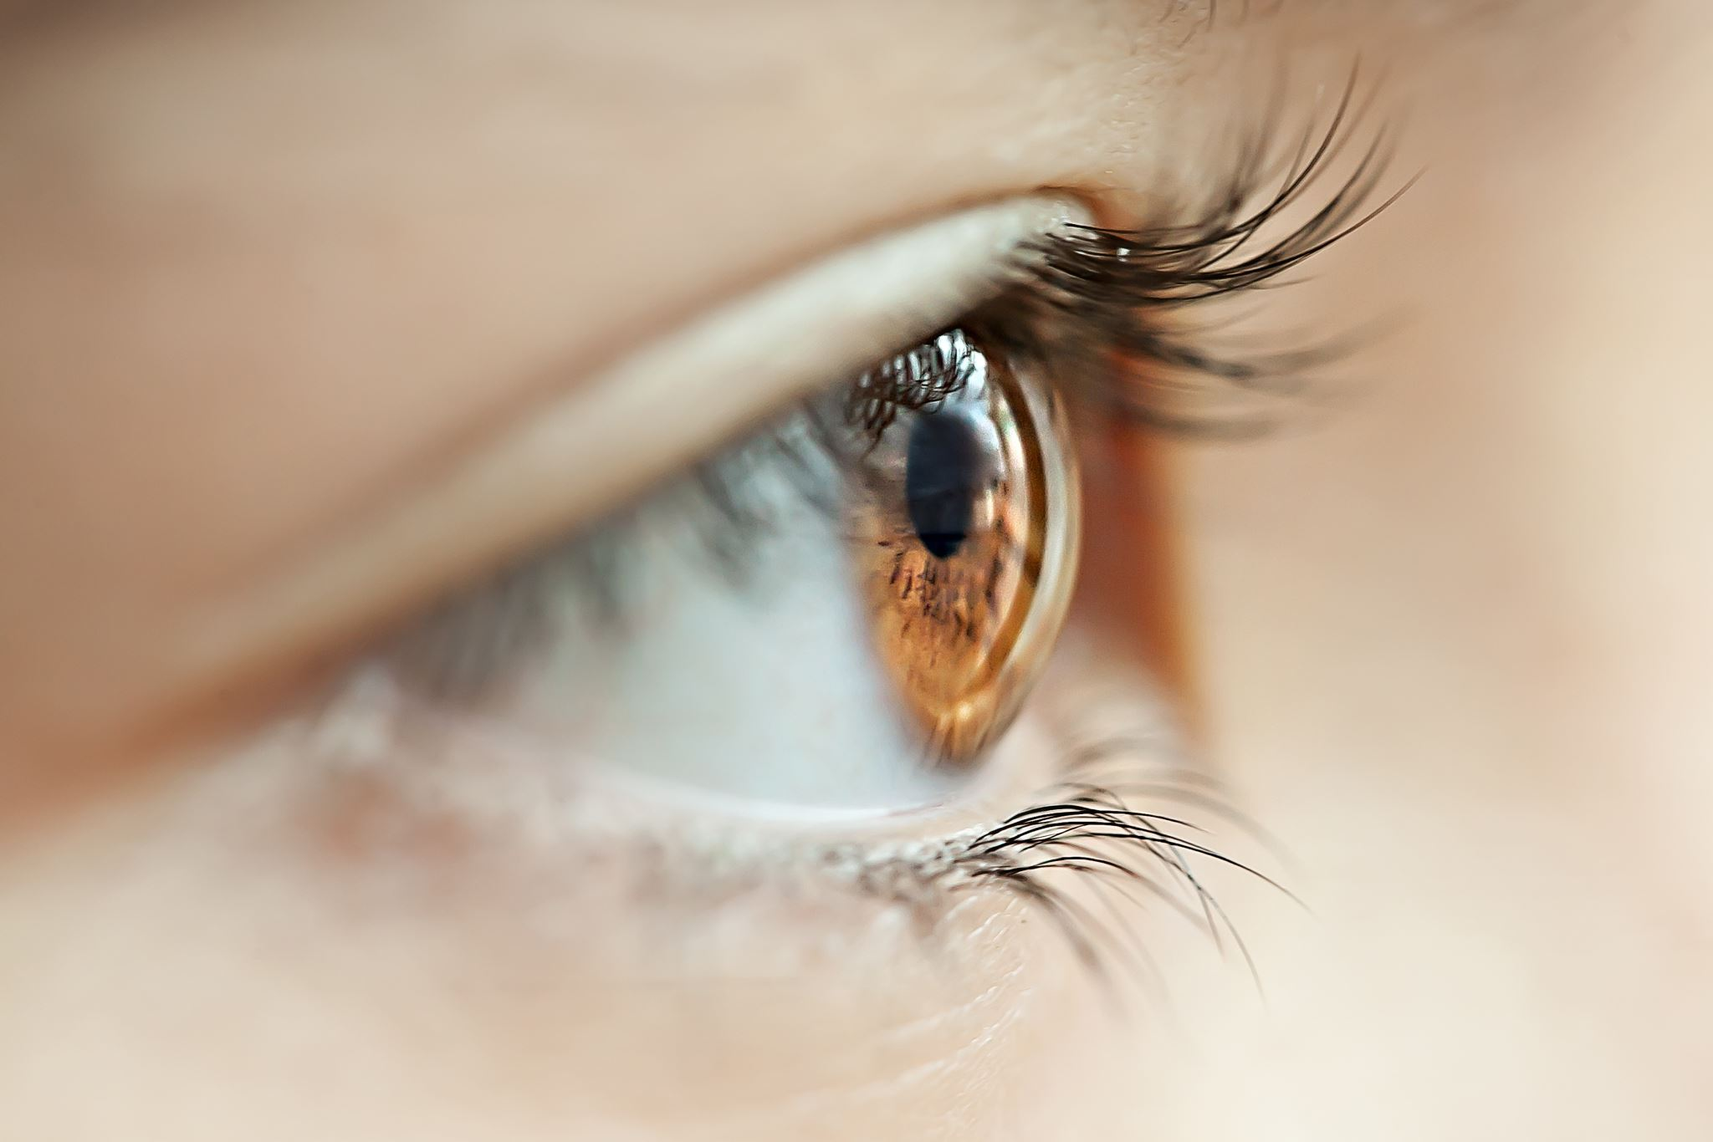
Red Eye Detection And Correction

Slide 2
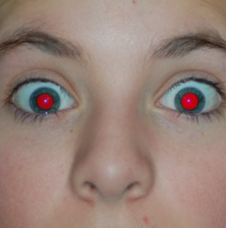
Red Eyes
Problem given by the use flashlight in dark environments.
Flashlight passing through enlarged pupils is reflected on the blood vessels and comes back at the camera lens.

Slide 3
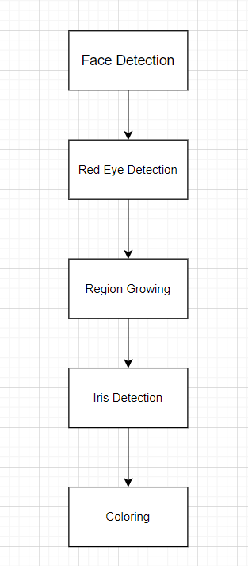
Steps

Slide 4
Face and Red Eyes Detection
Use Haar Cascade to detect the eyes.
Iterate through the eyes’ images.
Find the contour with the biggest area.

Slide 5
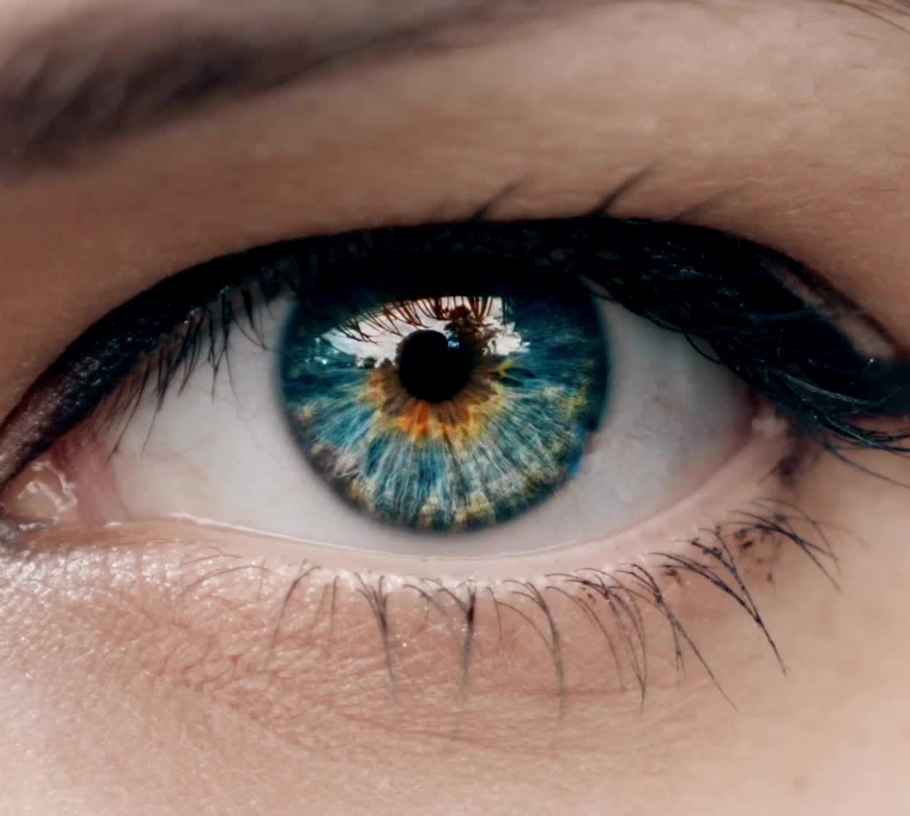
Eyes colouring
Make a mask in order to set to white the red pixels.
Split the image into channels and add blue and green values.
Update the pixels with mean using blue and green channels.
Make the image rgb at the end.

Slide 6
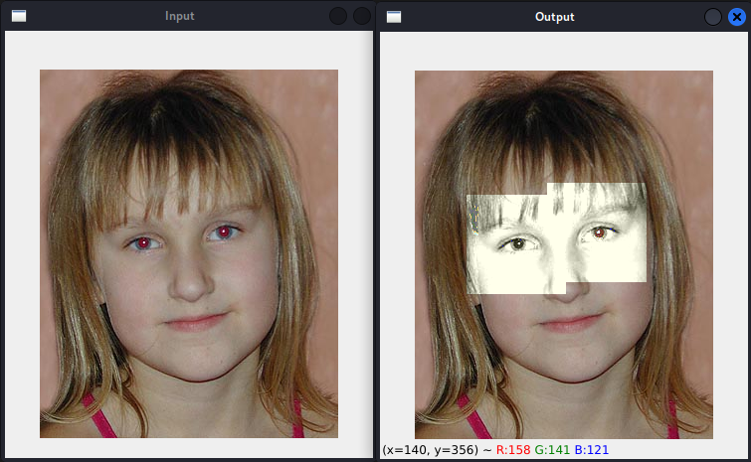
Experimental results
The eyes are corrected, but there are still problems with the contour of the eyes that remains grayscale

Slide 7
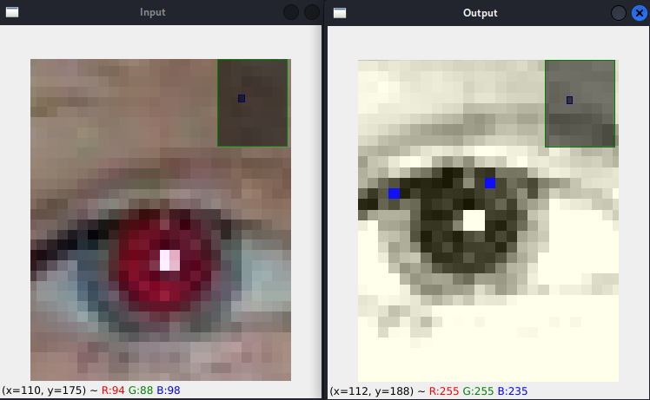
Previous vs Now

Slide 8
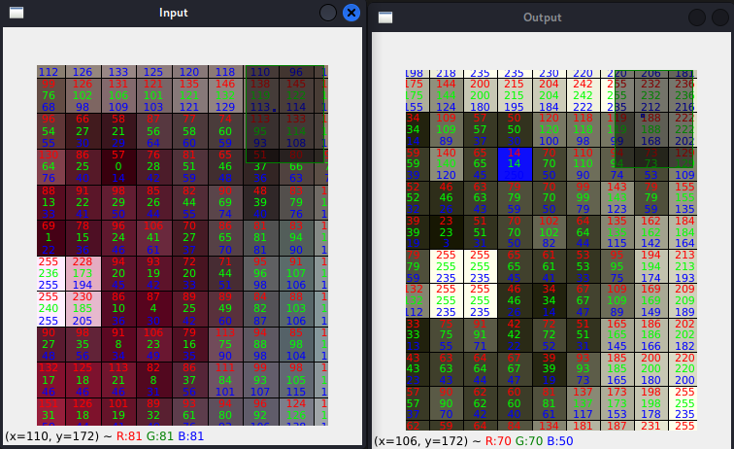
In depth analysis

Slide 9
Conclussions
For future implementations, it is better to do anything on rgb pictures.
The mean of the colour channels should be calculated differently, not using the arithmetic mean as usual.
The face detection is more efficient using haar cascade.

